Slide 1
Making Beautiful Code
And what it looks like when we see bad code.

Slide 2
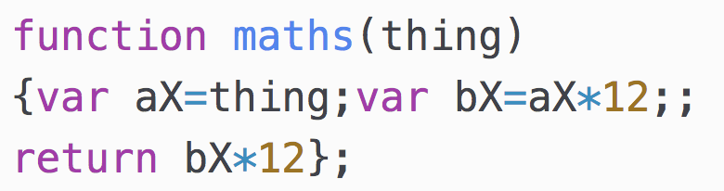
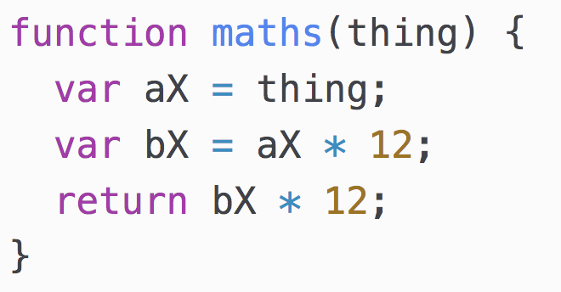
Syntax and Indentation
No indentation and strange semicolons/spacing
Indentation and correct semicolons/spacing

Slide 3
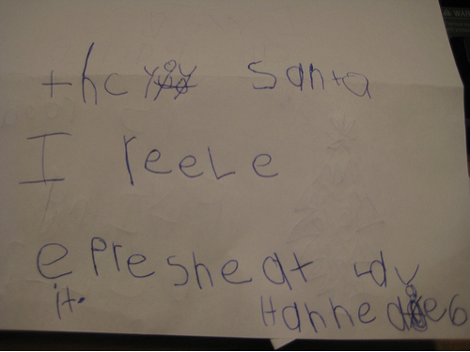
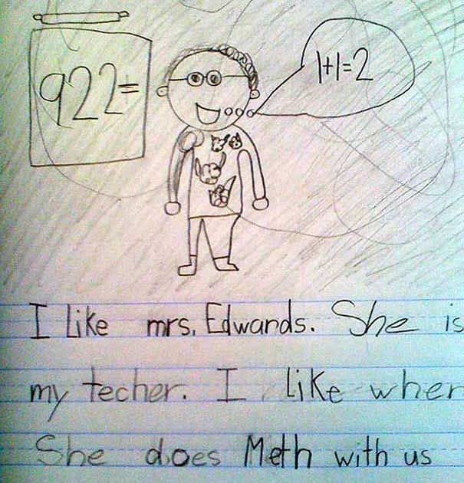
Syntax and Indentation
What it looks like to programmers
No indentation and strange semicolon
Indentation and correct semicolons

Slide 4
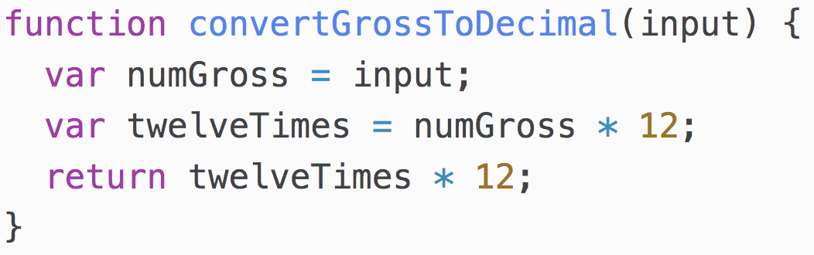
Function and Variable Names
Bad naming
Better naming

Slide 5
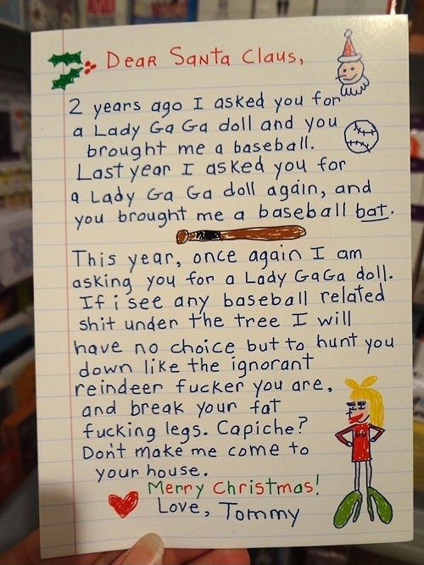
Function and Variable Names
What it looks like to programmers
With good variable names
Without good variable names

Slide 6
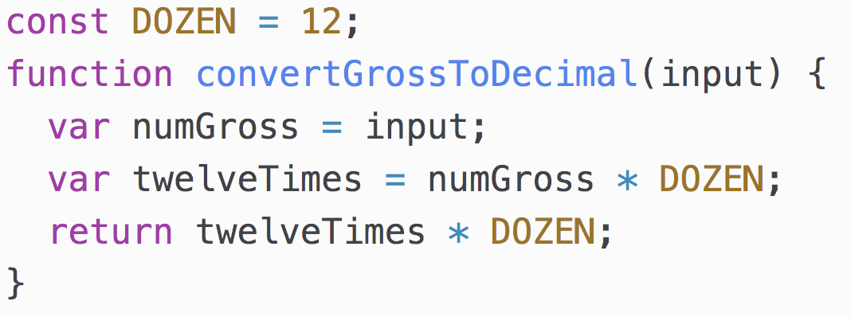
Remove “Magic Numbers”
Has magic numbers
Magic numbers removed

Slide 7
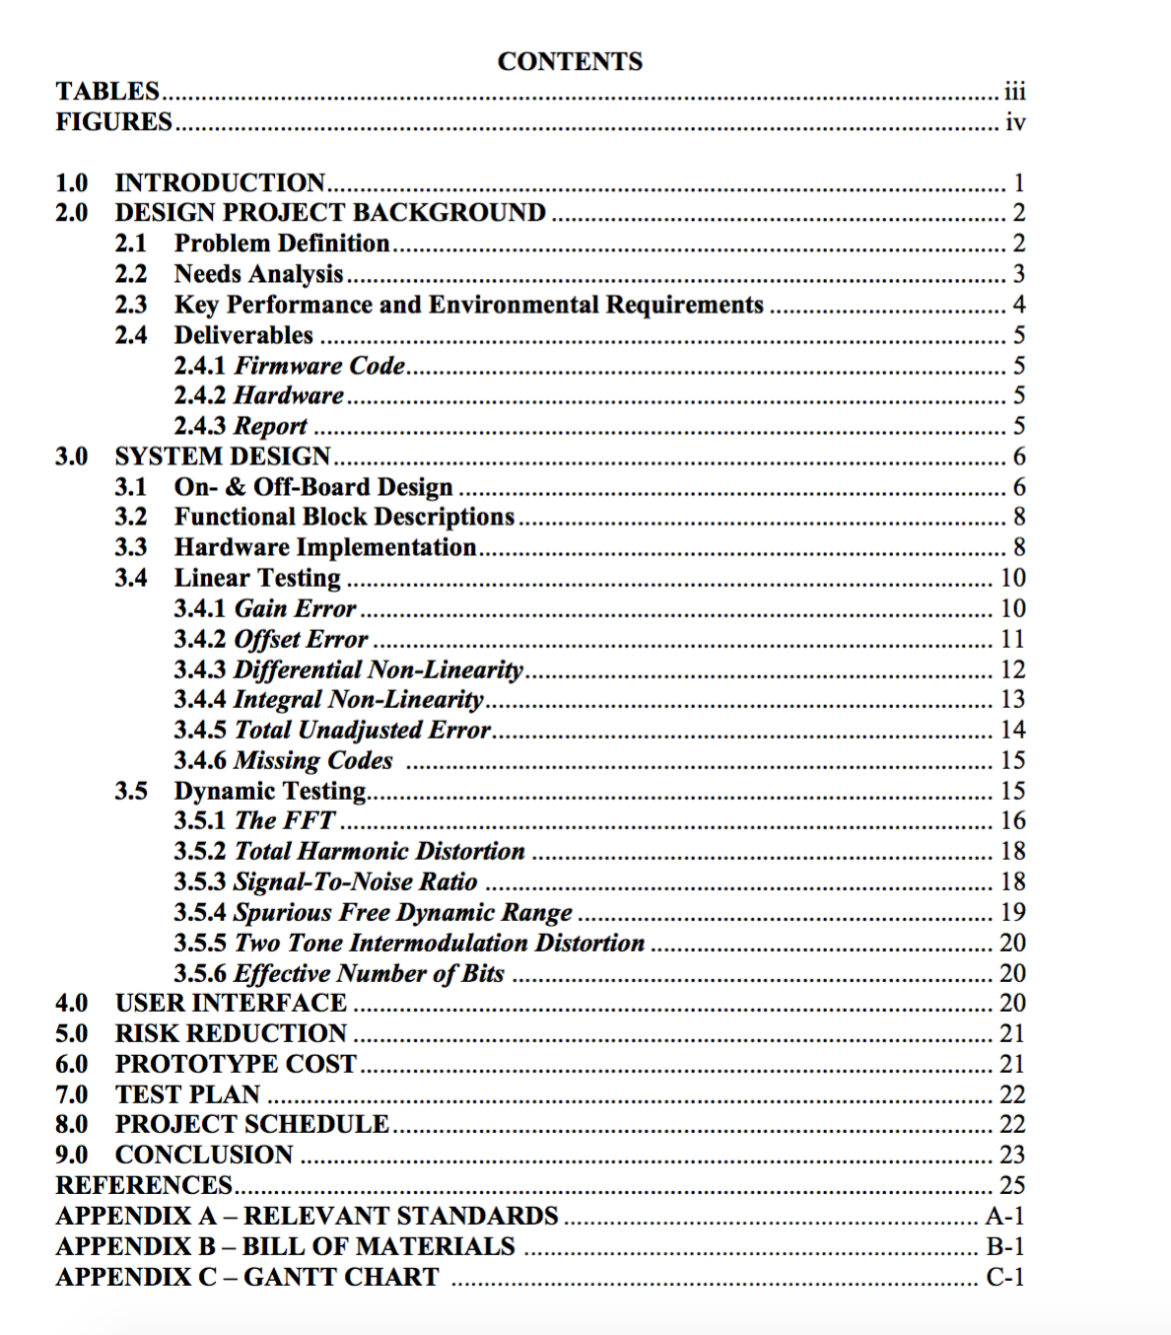
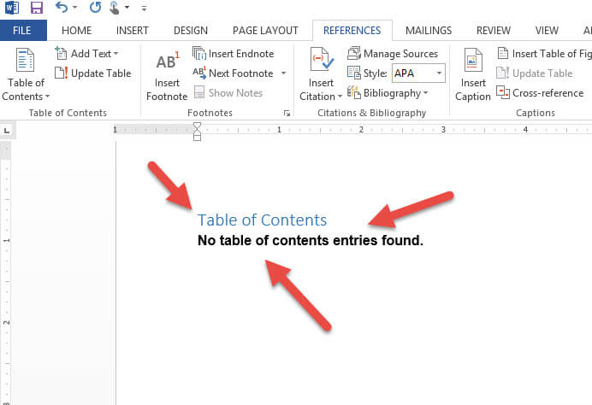
Remove “Magic Numbers”
What it looks like to programmers
Without magic numbers
With magic numbers

Slide 8
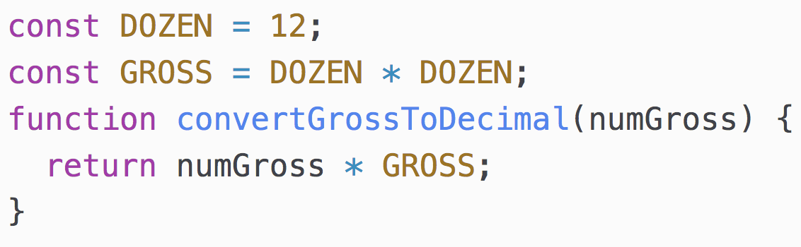
Simplify
Not simplified
Simplified

Slide 9
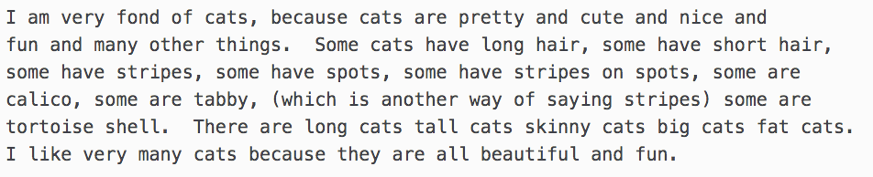
Simplify
What it looks like to programmers
Not simplified
Simplified

Slide 10
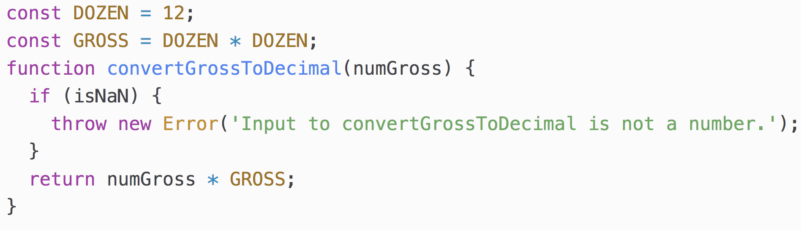
Validate Inputs
No validation of inputs
Validation of inputs

Slide 11


Validate Inputs
What it looks like to programmers
No Validation
With Validation

Slide 12
Other Improvements
Modularization and Cleaning development code

Slide 13
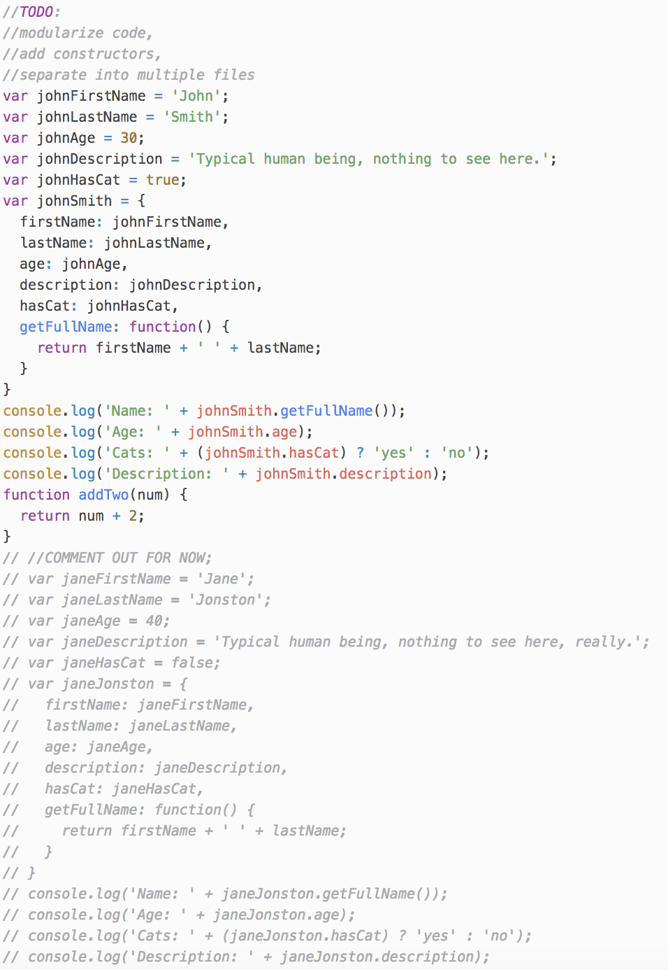
Cleaning up development code
Once you have developed code, you may realize you have left extra comments from the development cycle in your files.
Make sure before you publish to prod you remove any TODOs, or any other type of development comments
Make sure you remove commented out code
Make sure you remove any unused functions, especially if they will never be used in the future. (If they might be used in the future it is okay to leave in the code for now)

Slide 14
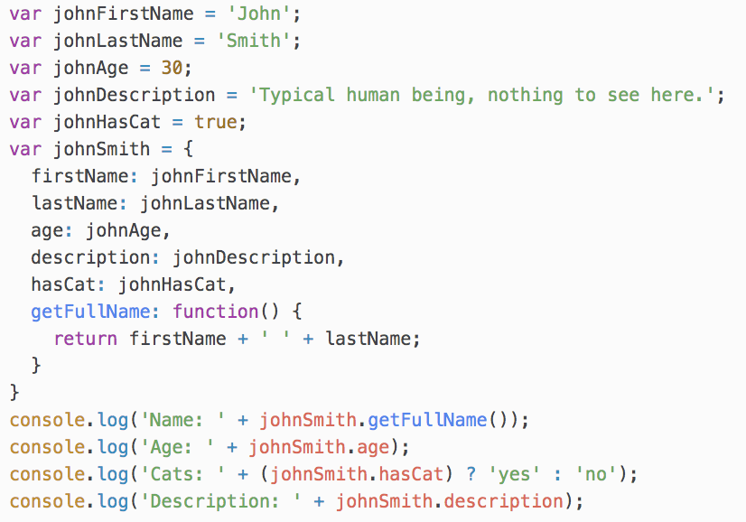
Cleaning up development code
Comments left in code
Remove all things left from development
=>

Slide 15
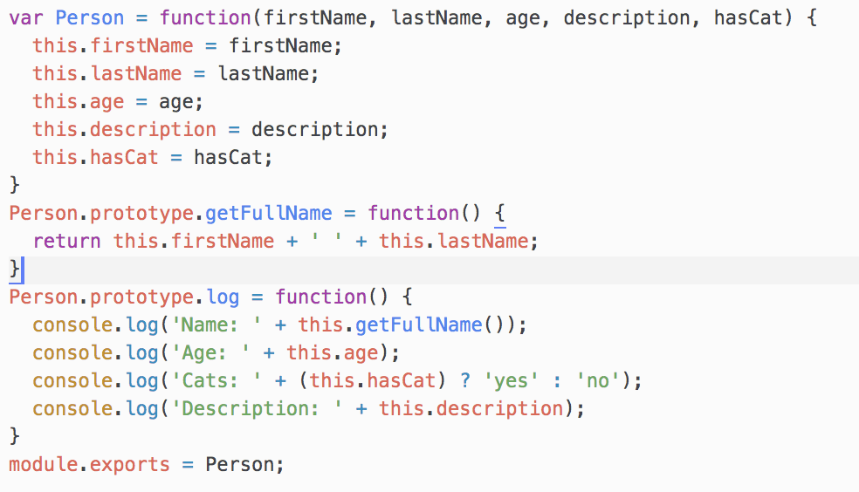
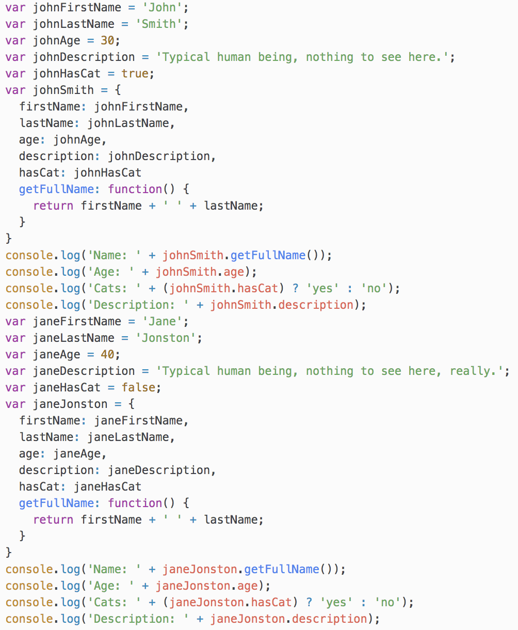
Modularization
Put things into functions/constructors…
Not Modularized
=>

Slide 16
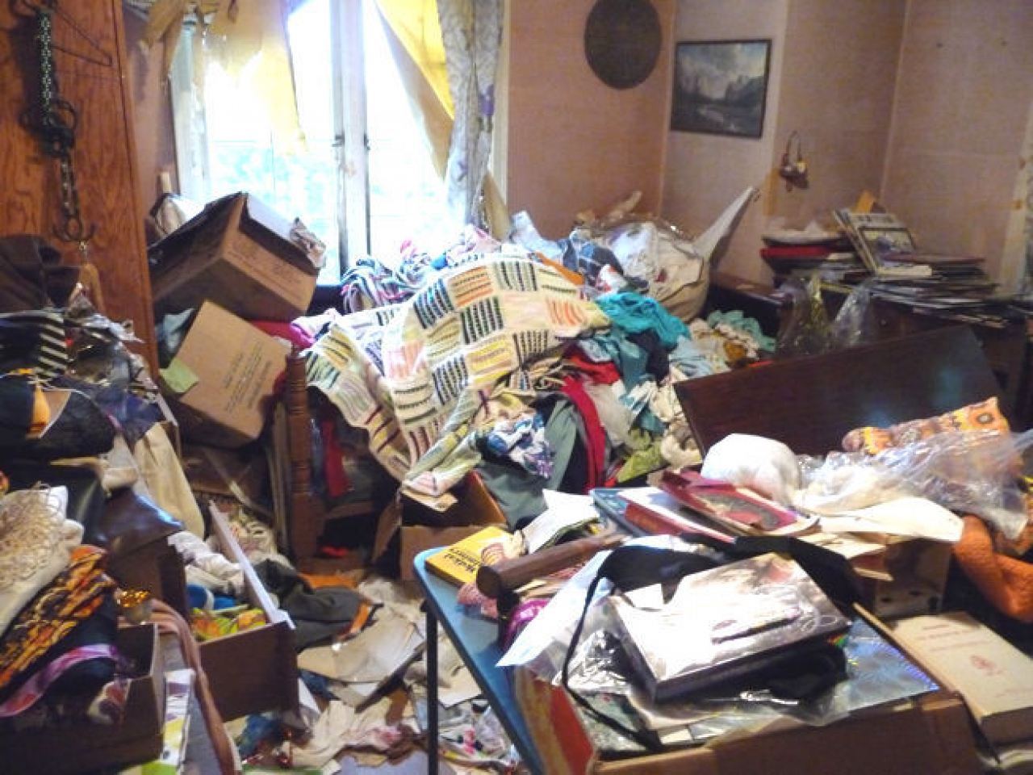

Modularization and cleaned up code.
What it looks like to programmers
Without modularization and with
Development code left inside
Modularized and cleaned

Slide 17
There’s always ways to improve!
This list was not exhaustive on
the ways you can improve your code.
These were just a few things you
can do to improve code quality!

